Slide 1
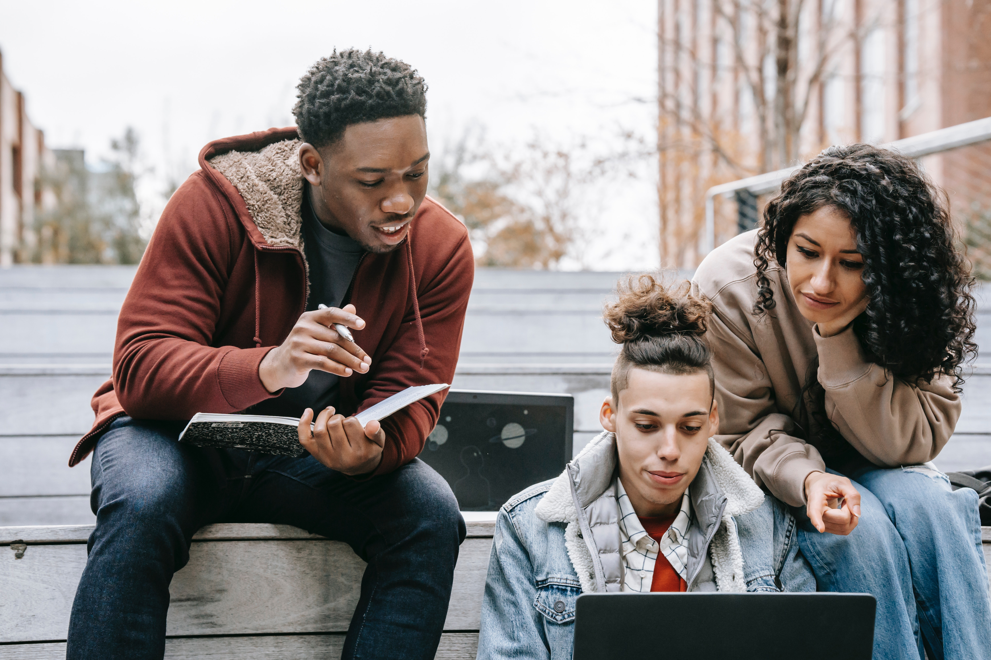

An Equity Review Tool
Evaluating Instructional Materials for Equity-Minded Practice

Slide 2
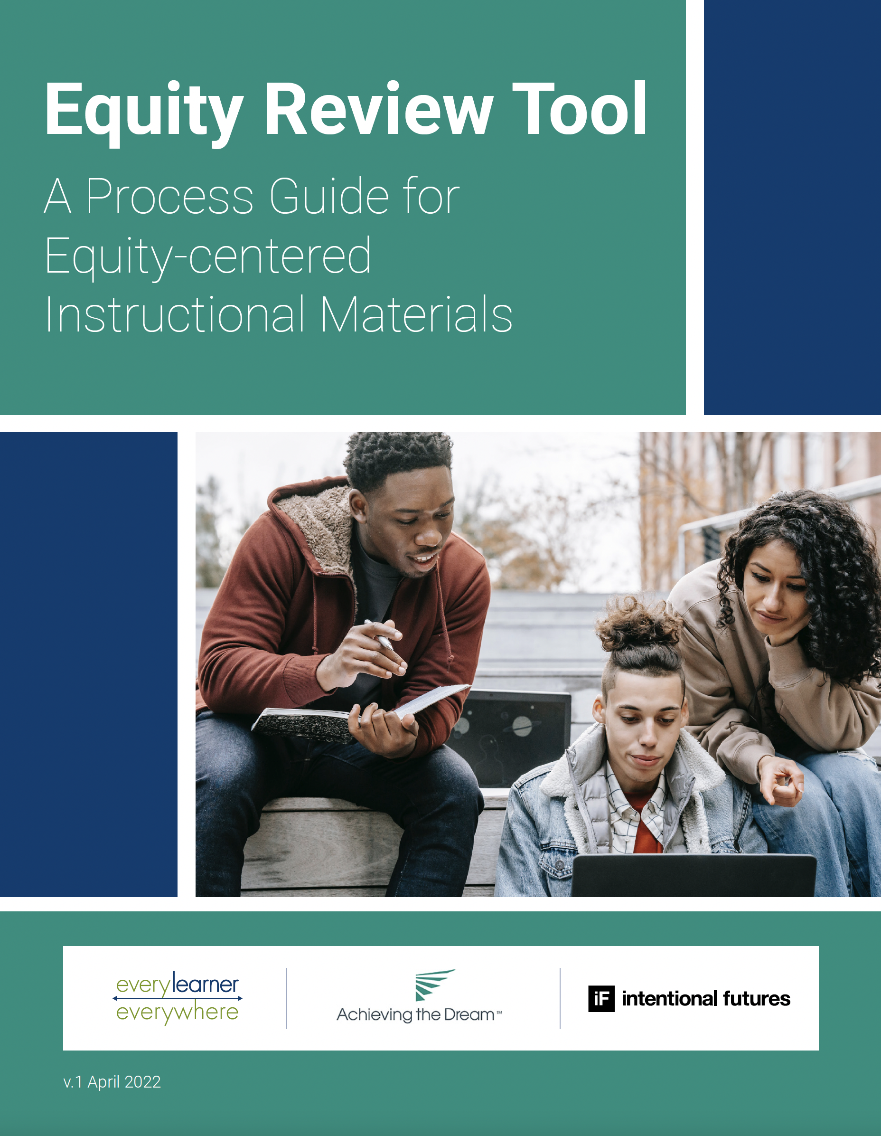

Slide 3
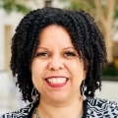

Dr. Ruanda Garth-McCullough Director, Program Development
Tynan Gable
Lead Strategist, Social Impact

Slide 4
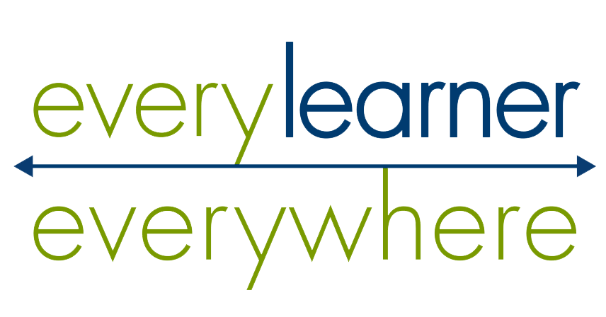
Agenda
Background and Framing
Overview of the Equity Review Tool
Chapter 1: Critical introspection and learning to set a foundation
Chapter 2: Develop equity-minded materials and conduct a self-review
Chapter 3: Review and continuously improve your materials
Tynan Gable
Lead Strategist, Social Impact
Closing Q&A
An Equity Review Tool | 4

Slide 5
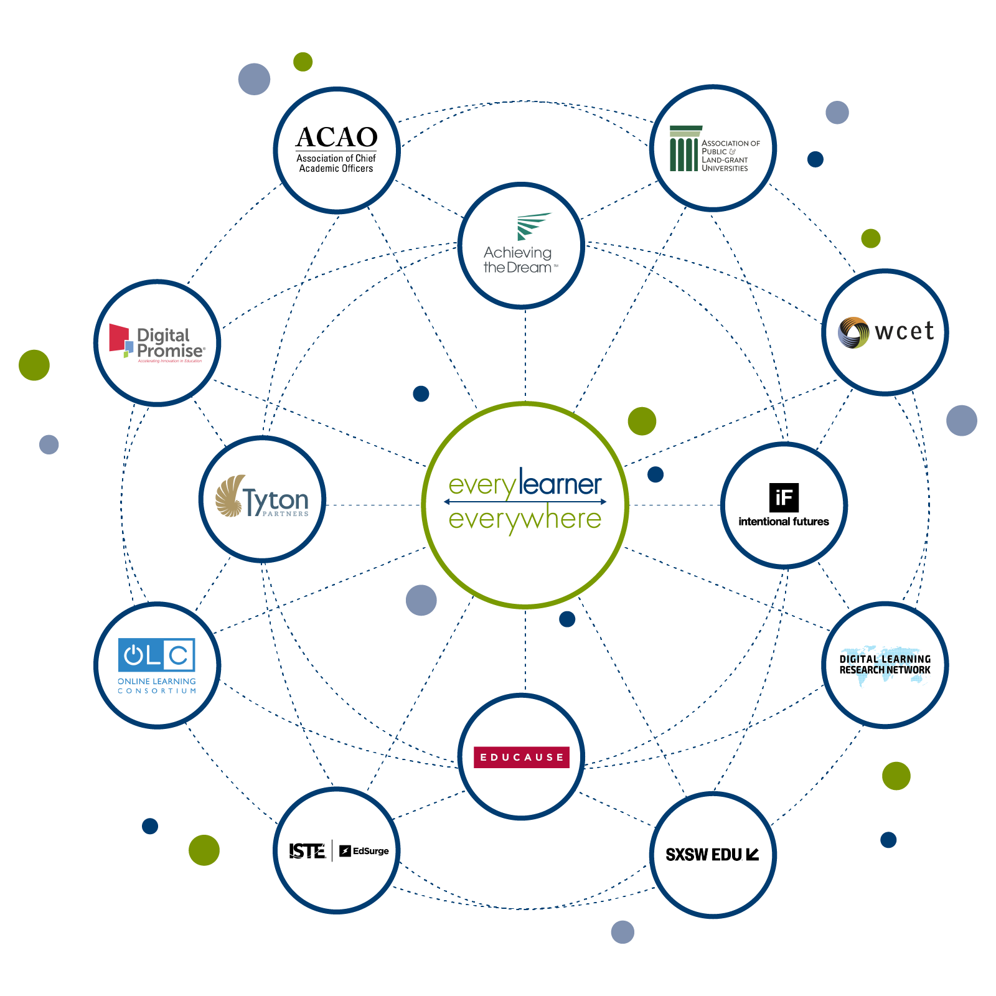
Every Learner Everywhere
The Every Learner Everywhere network includes 12 education organizations who share a drive to advance equity by transforming postsecondary teaching and learning. Our collective mission is to help institutions use technology to innovate teaching and learning, with the ultimate goal of improving student outcomes for Black, Latinx, Indigenous poverty-affected, and first-generation students.
Tynan Gable
Lead Strategist, Social Impact
An Equity Review Tool | 5

Slide 6



The impetus of this resource
Equity
Purpose
Goals
The need for this tool began with our own journey as a network to create more equity-minded resources
Provide guidance for the development of instructional resources that amplify minoritized and marginalized voices and support optimal learning ​​
Promote the use of asset-based and equity-minded language that centers students who have been historically marginalized
An Equity Review Tool | 6

Slide 7
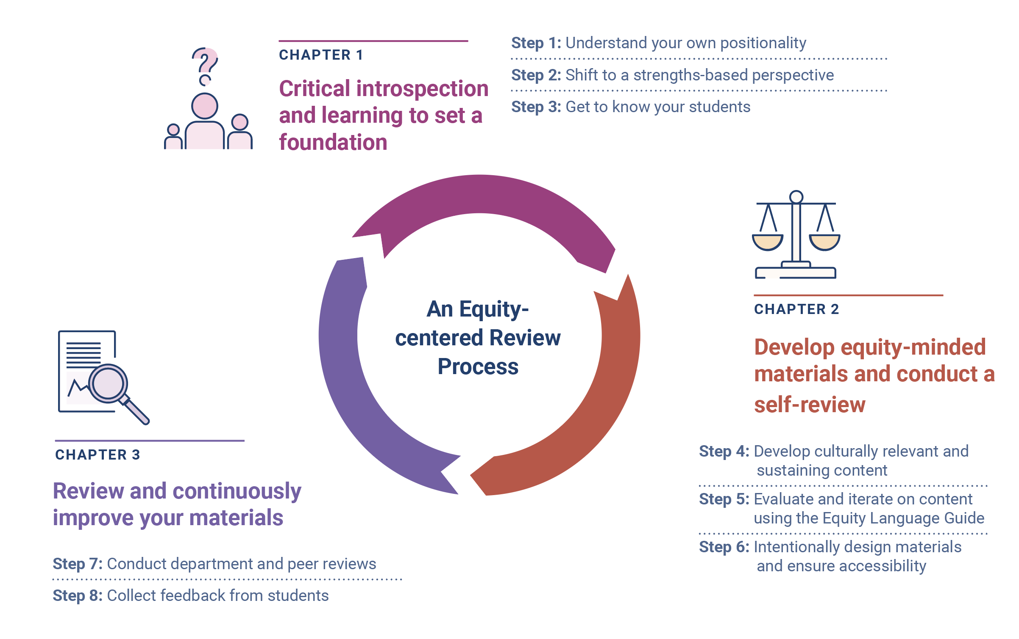
Overview of the Equity Tool
An Equity Review Tool | 7

Slide 8
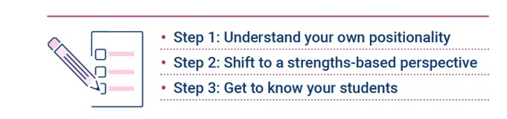
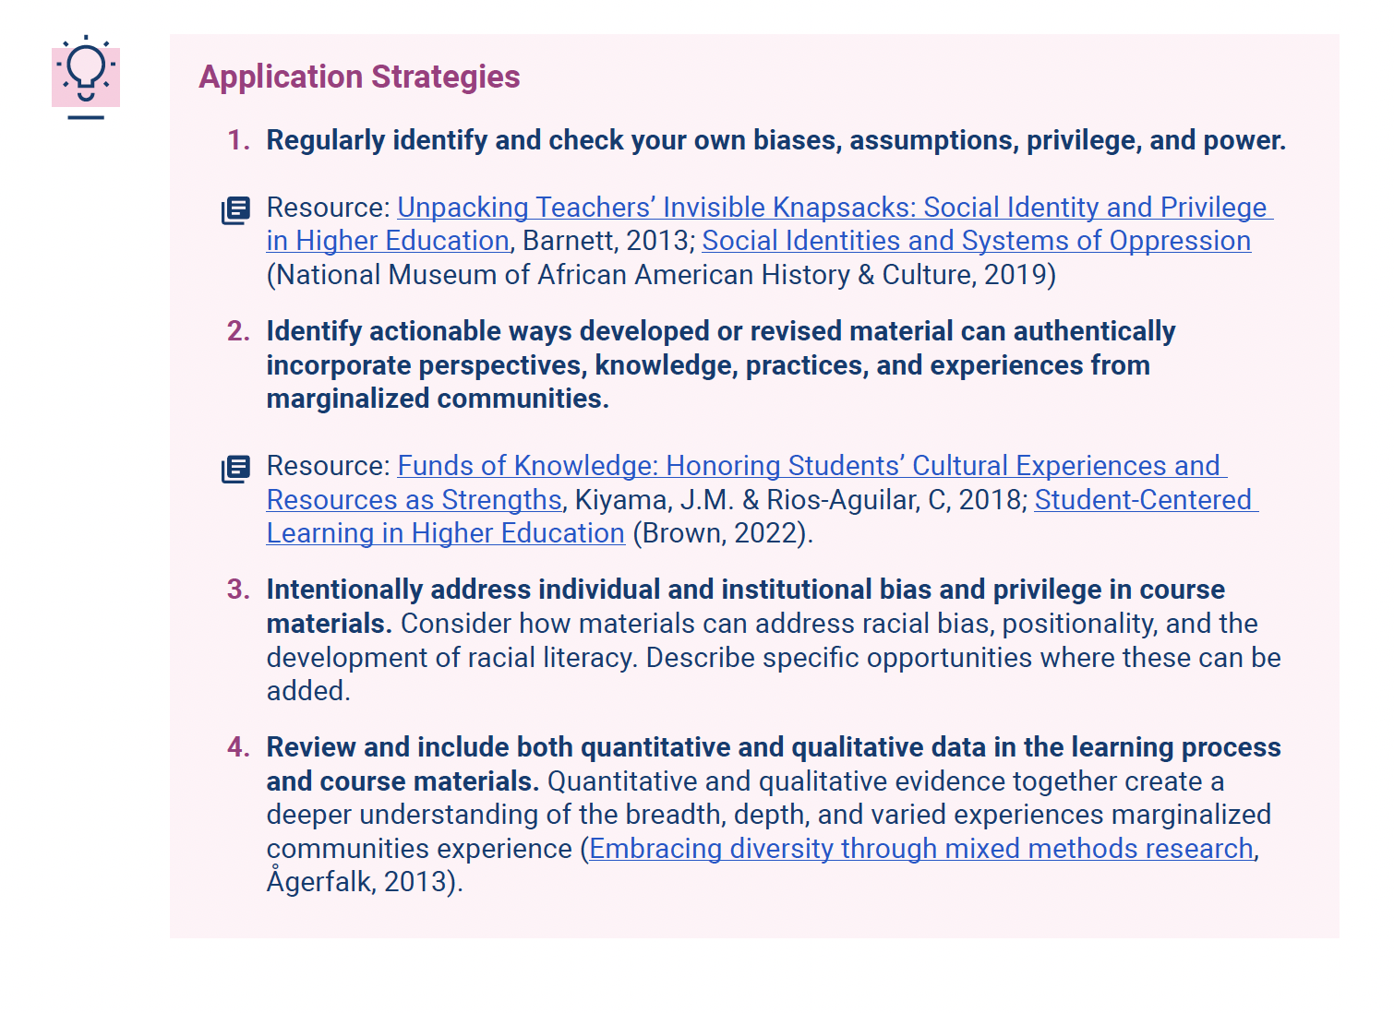
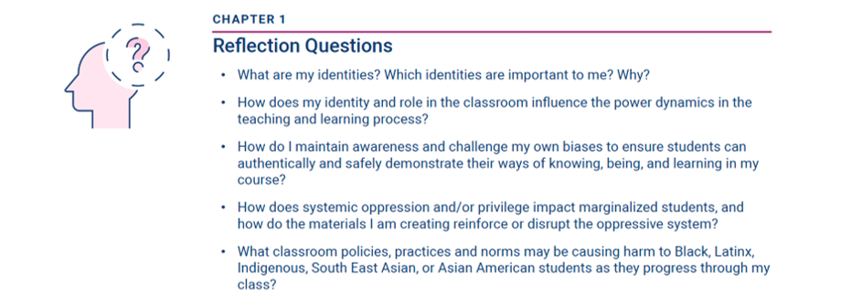
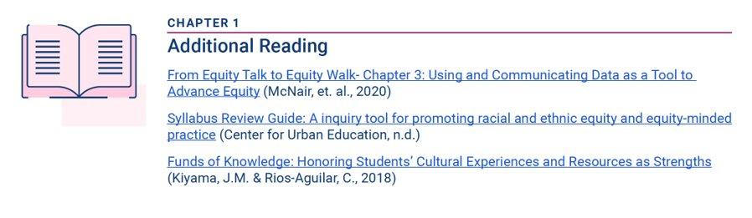
Overview of the Equity Tool
Step-by-step guidance for the development of equity-minded instructional resources
Application strategies that help bridge the gap from theory to action
Critical questions that confront privilege and exclusion
Resources for further learning
An Equity Review Tool | 8

Slide 9
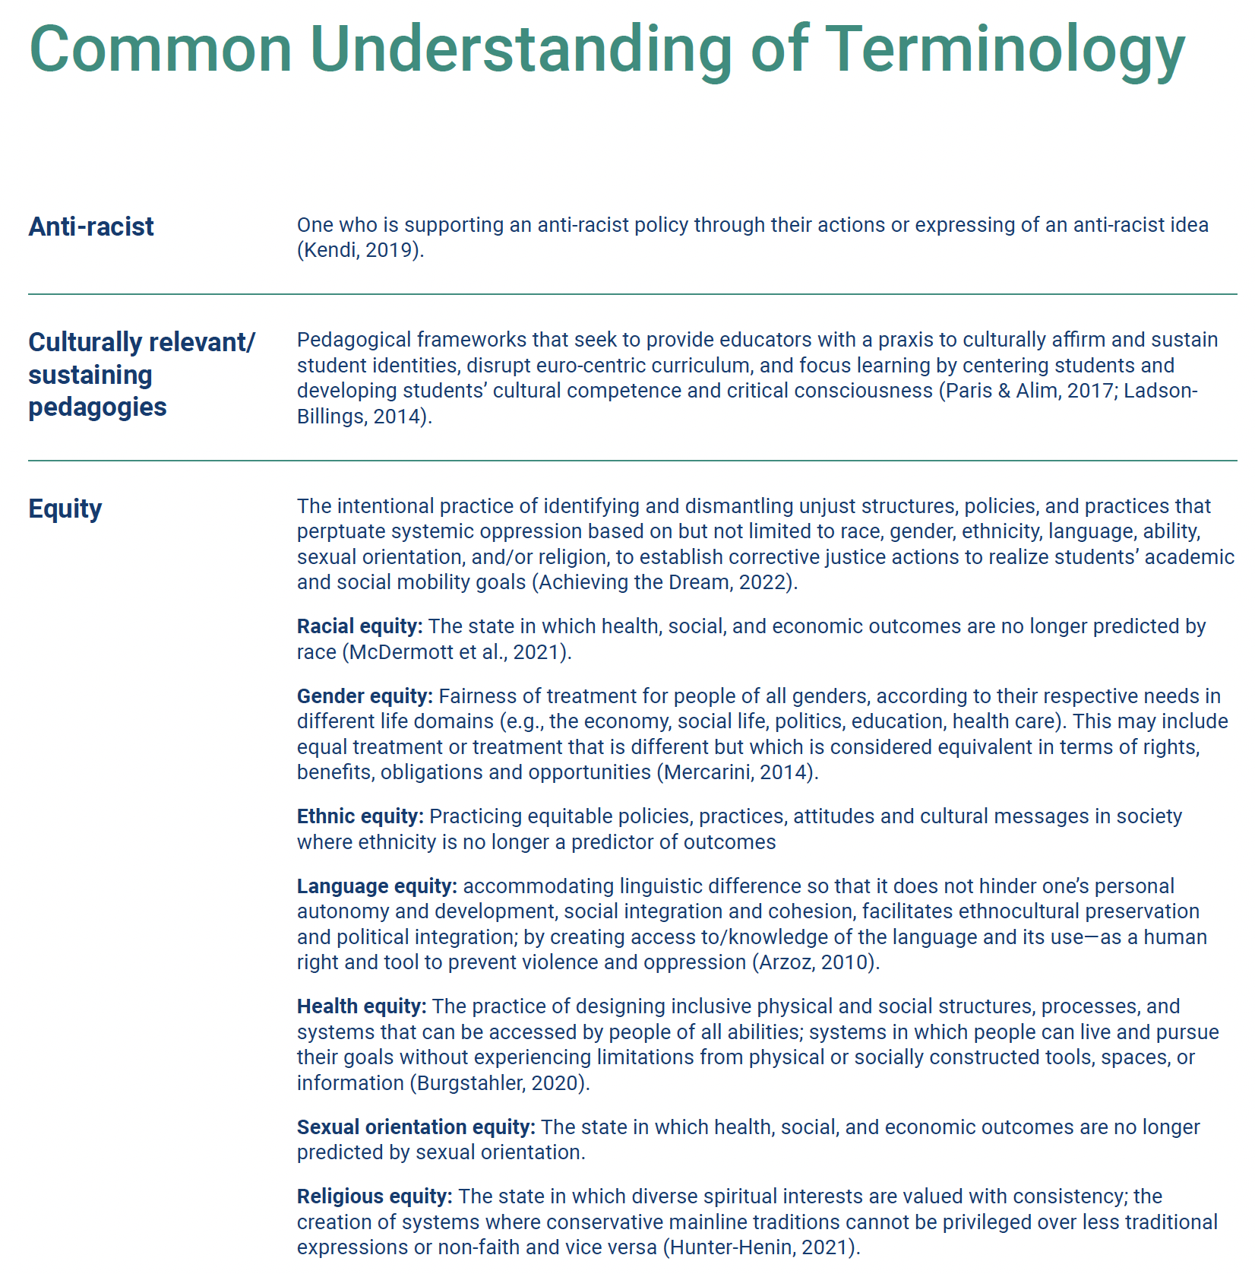
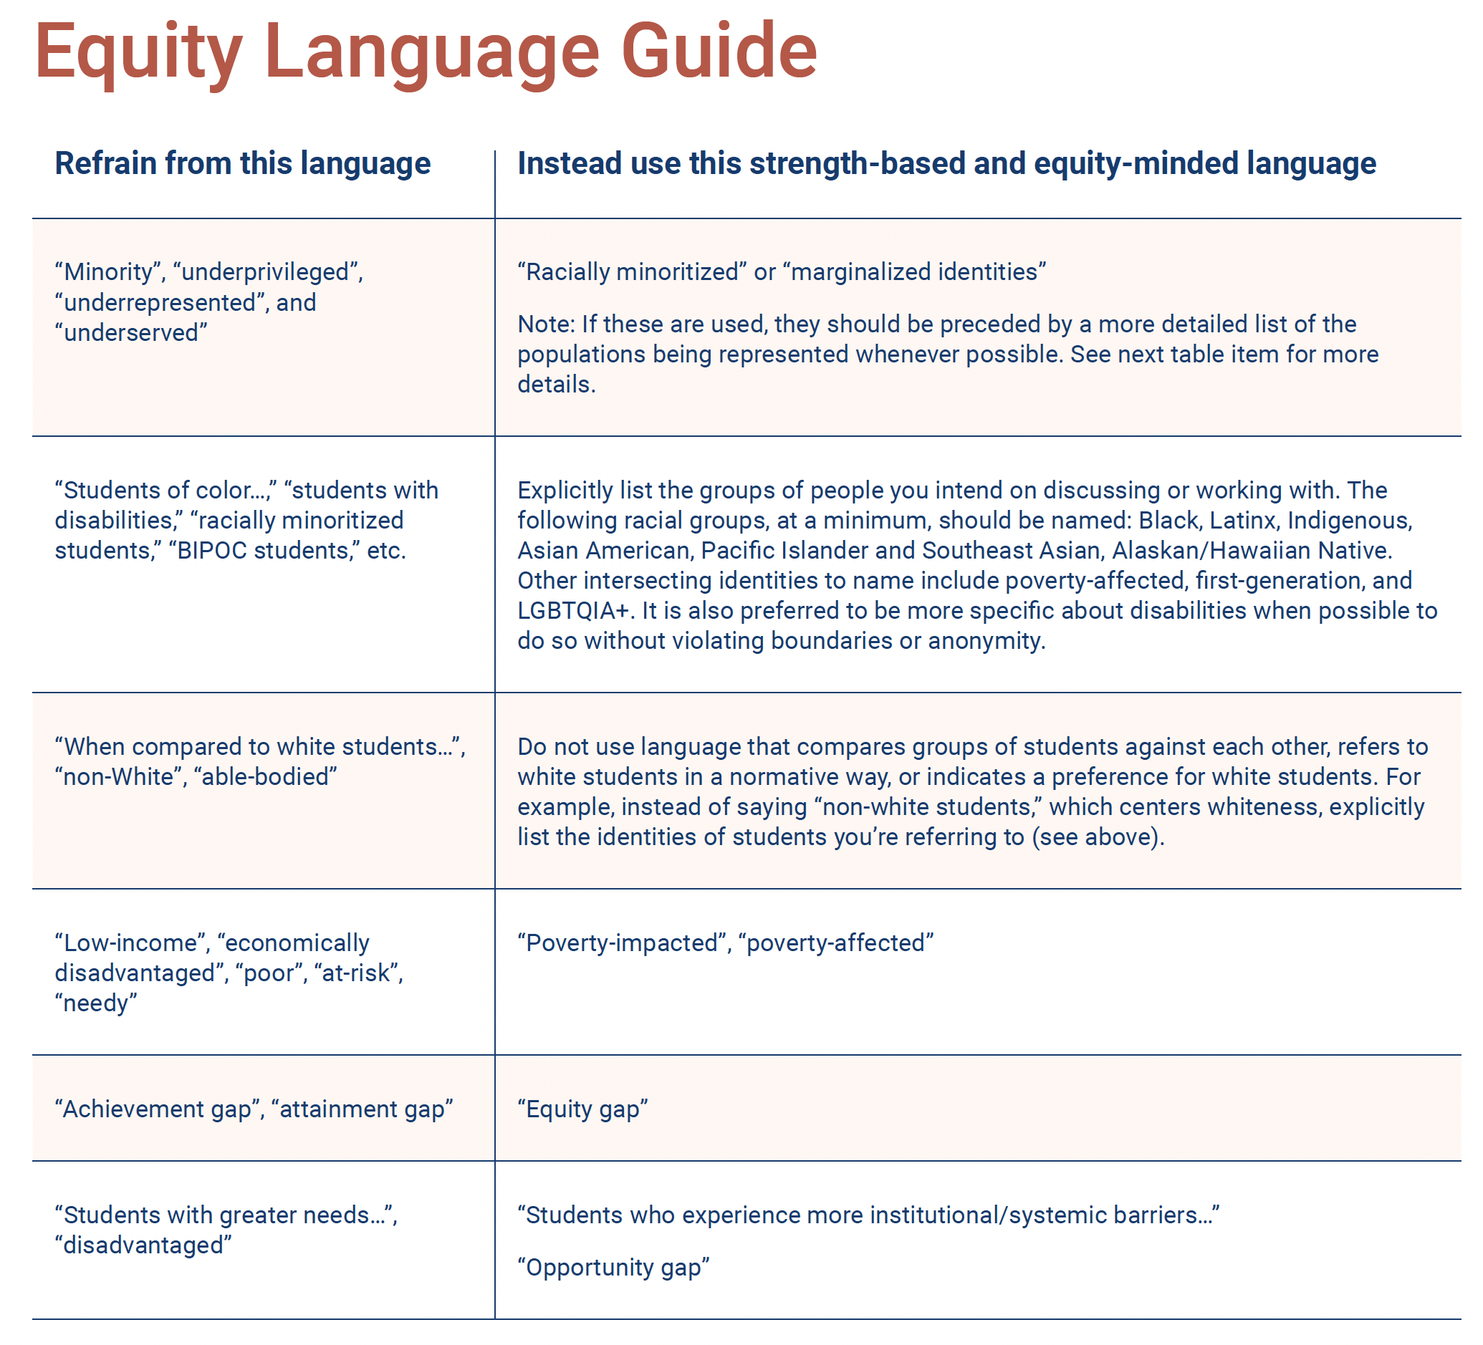
Overview of the Equity Tool
A couple highlights...
An Equity Review Tool | 9

Slide 10
What questions do you have?
Q & A

Slide 11
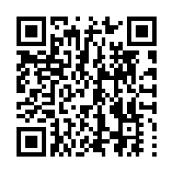
Download the full tool here!
Thank You!
Tynan@intentionalfutures.com
Rgarth-mccullough@achievingthedream.org

