Slide 1




Supporting Adjunct Faculty: Research-Based Recommendations
June 9, 2022
Van L. Davis, Ph.D., WCET
Abby McGuire, Ed.D., OLC

Slide 2



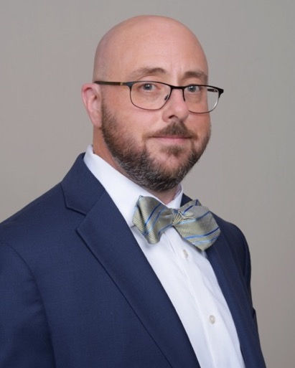

WELCOME & INTRODUCTIONS
Abby McGuire, Ed.D.
Van L. Davis, Ph.D.
Director of Research, OLC
abby.mcguire@onlinelearning-c.org
Chief Strategy Officer, WCET
Service Design & Strategy Officer,
Every Learner Everywhere
vdavis@wiche.edu

Slide 3

The Study
Summer 2021
Surveyed about the 2020-2021 academic year
116 participants
42.7% two-year, primarily associates; 25.6% four-year public, primarily baccalaureate and/or graduate; 28.1% private, nonprofit; 1.2% private, for profit; and 2.4% other
19.3% less than 500 FTE, 16.9% 500 to 1,000 FTE, 26.5% 1,001 to 3,000 FTE, 13.3% 3,001 to 5,000 FTE, and 24.1% more than 5,000 FTE

Slide 4

Section 1
Findings

Slide 5
Use of online adjuncts
The use of adjuncts for online courses in 2020-21 was slightly up compared to 2019-2020.

Slide 6
Professional Development: Modality Specific Training
Modality specific training is excellent for asynchronous online education but much less robust for other modalities, especially blended and hyflex courses.

Slide 7
Professional Development: Requirements
The majority of respondents require at least online technical training, academic student policy training, and effective teaching methods training.

Slide 8
Professional Development: Major Barriers
Time
Money
Availability of adjuncts
Autonomy of colleges and department
Lack of resources

Slide 9

Most Effective Practices by Adjuncts

Slide 10
Most Challenging Practices for Adjuncts

Slide 11
Most Effective Strategies for Supporting Adjuncts

Slide 12

Section 2
Recommendations

Slide 13
Effective Strategies for Supporting Adjunct faculty

Slide 14

Create Sustained, Structured Connections with Adjunct Faculty
Create one-on-one or small group mentoring programs to provide continuous support to online adjunct faculty. A program that offers a combination of regularly-scheduled meetings, as-needed interactions, and feedback from experienced faculty provides robust opportunities for connection and development for online adjunct faculty.

Slide 15

Offer training options that extend beyond traditional business hours
Offer training options that fit with adjunct faculty schedules. Offering asynchronous faculty training options, as well as synchronous or on-campus training on evenings and weekends can make it more likely adjuncts are available to attend.

Slide 16
Incentivize professional development options for online adjunct faculty
Compensate adjunct faculty for their time and incentivize attendance by offering compensation for professional development offerings.

Slide 17
Tailor training content to meet top online adjunct faculty challenges
Gather data to understand top faculty challenges at your institution and tailor training content to meet their needs.
According to this study, top challenges and topics for training include:
  Collaborative learning
  Creating connection between students
  Facilitating group discussion
  Active learning strategies
  Creating an inclusive classroom
  Culturally-relevant teaching

Slide 18
Provide recognition for exemplary online adjunct faculty who use effective practices
Acknowledge the successes of online adjunct faculty using effective practices to connect with students. Formal means of recognition include awards or the opportunity to be featured on the program’s website. Informal means of recognition might include a personal thank you email, message, or call.

Slide 19
Van L. Davis, PhD, Chief Strategy Officer, WCET
vdavis@wiche.edu
Abby McGuire, EdD, Director of Research, OLC
abby.mcguire@onlinelearning-c.org

Slide 20
For more information:
Online Adjunct Faculty: A Survey of Institutional Policies and Practices
https://www.everylearnereverywhere.org/resources/online-adjunct-faculty-a-survey-of-institutional-policies-and-practices/

Slide 21
For more information, Download
Supporting Online Adjunct Faculty Across Institutional Roles:
An Inclusive Playbook for Academic Leaders and Instructional Support Staff
Newly Released!

