Slide 1
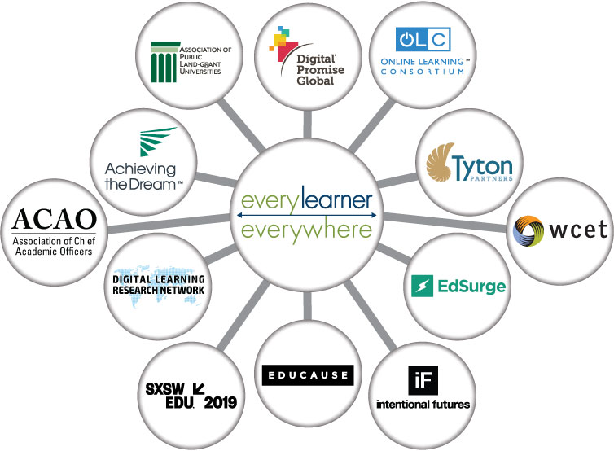


Strategies for Implementing Digital Learning Infrastructure to Support Equitable Outcomes

Slide 2
Goals of today’s conversation
Articulate the role that digital learning can play in supporting more equitable higher education outcomes
Share a framework for considering the implementation of digital learning infrastructure that supports equitable outcomes
Learn from academic leaders at institutions leading impact and change
https://www.everylearnereverywhere.org/resources/strategies-for-implementing-digital-learning-infrastructure-to-support-equitable-outcomes/
Notes:
What is the north star for your work? How do you measure success?
What are the key activities related to faculty support and professional learning that have driven success?
How do you ensure that students can access digital tools?
Ongoing key challenges you are grappling with?
Advice for institutions just getting started?

Slide 3
What is digital learning?
Technology and teaching practices that use technology to enhance learning
Includes a broad range of content and communication tools, curricular models, design strategies, and services that personalize instruction for students in face-to-face, blended, and online learning environments
Is integrated across all learning modalities and is NOT limited to online learning or fully online courses
Using digital learning, faculty can adapt instruction to students’ needs and capabilities, promote active and collaborative learning, more easily support learners with timely feedback, and improve academic outcomes

Slide 4
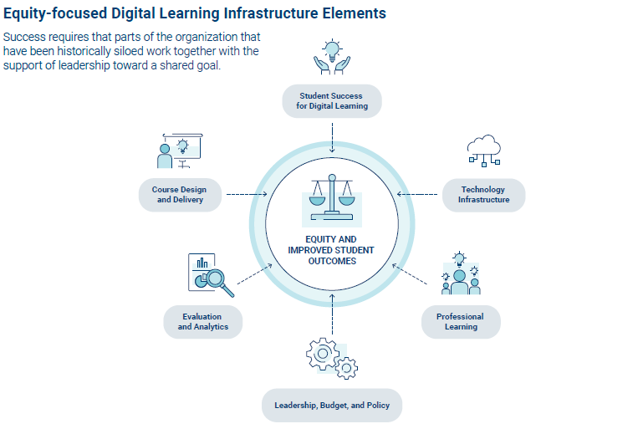
Key elements of digital learning infrastructure

Slide 5
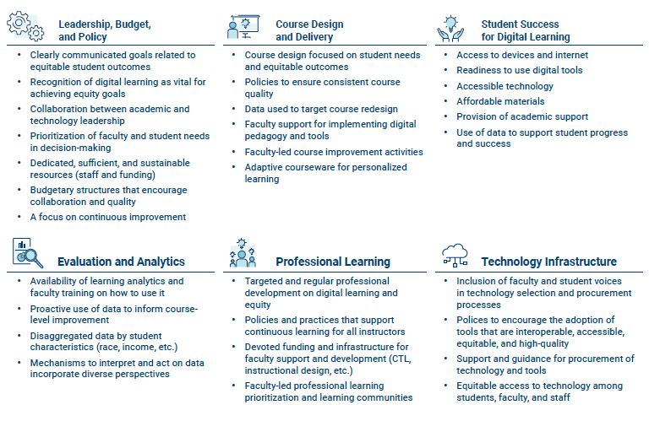
Across each element, key attributes must be in place to support implementation of digital learning that is equity-centered

Slide 6



Introductions
Bryan Berrett,
Interim Director, Office of Innovation and Digital Excellence for Academic Success, Fresno State
Beth Brunk-Chavez,
Dean,
University of Texas-El Paso
Kristen Fox,
Managing Director,
Tyton Partners

Slide 7

Reach out to learn more…
EVERY LEARNER EVERYWHERE
Every Learner Everywhere advocates for equitable outcomes in U.S. higher education through advances in digital learning. Our mission is to help institutions use new technology to innovate teaching and learning, with the ultimate goal of improving student outcomes for Black, Latinx, and Indigenous students, poverty-affected students, and first-generation students.
Our collaborative work to advance equity in higher education centers on the transformation of postsecondary teaching and learning. We build capacity in colleges and universities to improve student outcomes with digital learning through direct technical assistance, timely resources and toolkits, and ongoing analysis of institution practices and market trends.
TYTON PARTNERS
Tyton Partners is the leading provider of advisory services to the education market, with a unique dual practice offering in investment banking and strategy consulting services. In the higher education ecosystem, we work with a wide range of colleges and universities to tackle their biggest strategic challenges and develop and execute on plans that enable them to grow, evolve, and thrive. Tyton Partners helps clients drive teaching and learning innovation, scale online operations, diversify and grow revenue, improve student success, better align with workforce outcomes, and realize transformative public/private partnerships, mergers, and affiliations.
https://www.everylearnereverywhere.org/resources/strategies-for-implementing-digital-learning-infrastructure-to-support-equitable-outcomes/

